Slide 1





Multi-Dimensional Classisication via kNN Feature Augmentation
Bin-Bin Jia
Min-Ling Zhang
School of Computer Science and Engineering,
MOE Key Laboratory of Computer Network & Information Integration
Southeast University, China
Honolulu, Hawaii, USA
Notes:
Good morning, everyone. I’m Xuan Wu from Southeast University, Nanjing, China. It’s my pleasure to introduce our work: towards enabling binary decomposition for partial label learning. This is a joint work with my advisor, professor Min-Ling Zhang.

Slide 2
Multi-Dimensional Classification
Traditional Multi-class classification
Only one class variable
Multi-Dimensional Classification (MDC)
Multiple class variables
Notes:
In traditional supervised learning, each object is represented by a single instance associated with a single label. However, in partial label learning, each object is represented by a single instance while associated with a set of candidate labels, among which only one label is valid but unknown.

Slide 3
The Problem
Goal: induce multiple multi-class classifiers simultaneously
An intuitive strategy: training an independent multi-class classifier w.r.t. each class space
Another natural strategy: training a single multi-class classifier by treating each possible combination of class variables as a new class
Difficulty: modeling possible dependencies among class spaces carefully and appropriately
Our work:
Make a first attempt towards feature manipulation for MDC by generating kNN-augmented features
Notes:
The goal of partial label learning is to induce a multi-class classifier. To accomplish this task, an intuitive strategy is to fit widely-used learning techniques to PL data. Meanwhile, another natural strategy is to fit PL data to existing learning techniques. Specially, considering that the ultimate goal is to induce a multi-class classifier, binary decomposition should serve as the most straightforward solution. Unfortunately, due to the difficulty that the ground-truth label of the PL training example is concealed in its candidate label set, standard binary decomposition strategy can not be directly employed. In this paper, we aim to enable binary decomposition for partial label learning by adapting the popular one-vs-one decomposition techniques.

Slide 4
Outline
Introduction
The KRAM Approach
Experiments
Experiments setup
Experiments results
Conclusion
Notes:
This is the outline of my presentation. Firstly, I will introduce the basic setting of partial label learning.

Slide 5
Multi-Class Classification (MCC)
object
Input Space
represented by a single instance characterizing its properties
Output Space
associated with a single class variable characterizing its semantics
Only one label in the single class space is relevant.
Notes:
In traditional supervised learning, for each object, the input space is represented by a single instance, while the output space is associated with a single label. In the training phase, based on such objects and supervised learning algorithm, a predictive model can be induced. In the testing phase, given an unseen instance, its label can be predicted by this model.

Slide 6
Multi-Label Classification (MLC)
object
Input Space
represented by a single instance characterizing its properties
Output Space
associated with a single class variable characterizing its semantics
Multiple labels in the single class space are relevant.
Notes:
In traditional supervised learning, for each object, the input space is represented by a single instance, while the output space is associated with a single label. In the training phase, based on such objects and supervised learning algorithm, a predictive model can be induced. In the testing phase, given an unseen instance, its label can be predicted by this model.

Slide 7
Multi-Label Classification (MLC)
object
Input Space
represented by a single instance characterizing its properties
Both MCC and MLC assume one single homogeneous class space.
Output Space
associated with a single class variable characterizing its semantics
Multiple labels in the single class space are relevant.
Notes:
In traditional supervised learning, for each object, the input space is represented by a single instance, while the output space is associated with a single label. In the training phase, based on such objects and supervised learning algorithm, a predictive model can be induced. In the testing phase, given an unseen instance, its label can be predicted by this model.

Slide 8
Multi-Dimensional Classification
object
Multiple labels are relevant with each of them from one heterogeneous class space.
Notes:
In traditional supervised learning, for each object, the input space is represented by a single instance, while the output space is associated with a single label. In the training phase, based on such objects and supervised learning algorithm, a predictive model can be induced. In the testing phase, given an unseen instance, its label can be predicted by this model.

Slide 9
What’s more…
Mathematical view of multi-label classification:
MLC’s output space can be regarded as multiple binary class variables similar to MDC. But conceptually, they are all in the same class space.
Key difference between MDC and MLC
MDC usually assumes heterogeneous semantic spaces
MLC usually assumes homogeneous semantic space
Notes:
In traditional supervised learning, for each object, the input space is represented by a single instance, while the output space is associated with a single label. In the training phase, based on such objects and supervised learning algorithm, a predictive model can be induced. In the testing phase, given an unseen instance, its label can be predicted by this model.

Slide 10


MDC examples
rock, popular, classical, etc.
Dim. 1: Genre
Dim. 2: Instrument
piano, violin, guitar, etc.
English, Chinese,
Spanish, etc.
Dim. 3: Language
A piece of music
Dim. 1: Topic
sports, politics, social, Sci&Tech, etc.
Dim. 2: Mood
good news, neutral news, bad news
Dim. 3: Zone
domestic, intra-/inter-continental
news document
Notes:
Here are two simple scenarios where partial label learning problem arises.
The first one is when we try to annotate the painting style of this image. Suppose three annotators A, B and C labels it as Picasso style, Monet style and Van Gogh style respectively. Among which, only the labeling of Van Gogh style is correct.
The second one is when we try to obtain the correspondence between a picture and its description. For example, this picture is a screenshot of a tv show, we can easily find two human faces in the picture and two names in the subtitle. However, we don’t know the correspondence between each face and the names in the subtitle.
Actually, partial label learning problem widely exists in real-world applications, such as computer vision, image classification, learning from crowds, ecoinformatics, and so on.

Slide 11
MDC examples
rock, popular, classical, etc.
Dim. 1: Genre
piano, violin, guitar, etc.
Widely exist in real-world applications
Dim. 2: Instrument
English, Chinese,
Spanish, etc.
Text classification [Theeramunkong & Lertnattee, COLING’02] [ Ortigosa-Hernandez et al., Neurocomputing12] [Tu et al., ACM TIST17]
Dim. 3: Language
A piece of music
Bioinformatics [Rodriguez et al. TSMC-C12] [Borchani et al., AIM13] [Fernandez-Gonzalez et al., ICML Workshop’15]
Dim 1: Topic
sports, politics, social, Sci&Tech, etc.
Learning from crowds [Hernandez-Gonzalez et al., IJIS15]
Dim. 2: Mood
good news, neutral news, bad news
Ecology [Dzeroski et al, Applied Intelligence00][Kocev et al., ECML’07 ]
……
domestic, intra-/inter-continental
Dim. 3: Zone
news document
Notes:
Here are two simple scenarios where partial label learning problem arises.
The first one is when we try to annotate the painting style of this image. Suppose three annotators A, B and C labels it as Picasso style, Monet style and Van Gogh style respectively. Among which, only the labeling of Van Gogh style is correct.
The second one is when we try to obtain the correspondence between a picture and its description. For example, this picture is a screenshot of a tv show, we can easily find two human faces in the picture and two names in the subtitle. However, we don’t know the correspondence between each face and the names in the subtitle.
Actually, partial label learning problem widely exists in real-world applications, such as computer vision, image classification, learning from crowds, ecoinformatics, and so on.

Slide 12
Existing approaches
An intuitive strategy: training an independent multi-class classifier w.r.t. each class space (Binary Relevance, BR)
Another natural strategy: training a single multi-class classifier by treating each possible combination of class variables as a new class (Class Powerset, CP)
Other specifically designed approaches:
Specifying chaining order over class variables [Zaragoza et al., IJCAI’11; Read et al., Pattern Recognition14]
Partitioning class variables into groups [Read et al., TKDE14]
Assuming DAG structure over class variables [Bielza et al., IJAR11; Batal et al., CIKM’13; Zhu et al., Applied Intelligence16; Bolt & van der Gaag, IJAR17; Benjumeda et al., IJAR18]
Notes:
Here are two simple scenarios where partial label learning problem arises.
The first one is when we try to annotate the painting style of this image. Suppose three annotators A, B and C labels it as Picasso style, Monet style and Van Gogh style respectively. Among which, only the labeling of Van Gogh style is correct.
The second one is when we try to obtain the correspondence between a picture and its description. For example, this picture is a screenshot of a tv show, we can easily find two human faces in the picture and two names in the subtitle. However, we don’t know the correspondence between each face and the names in the subtitle.
Actually, partial label learning problem widely exists in real-world applications, such as computer vision, image classification, learning from crowds, ecoinformatics, and so on.

Slide 13
Existing approaches
An intuitive strategy: training an independent multi-class classifier w.r.t. each class space (Binary Relevance, BR)
Another natural strategy: training a single multi-class classifier by treating each possible combination of class variables as a new class (Class Powerset, CP)
Output space!!!
Other specifically designed approaches:
Specifying chaining order over class variables [Zaragoza et al., IJCAI’11; Read et al., Pattern Recognition14]
Partitioning class variables into groups [Read et al., TKDE14]
Assuming DAG structure over class variables [Bielza et al., IJAR11; Batal et al., CIKM’13; Zhu et al., Applied Intelligence16; Bolt & van der Gaag, IJAR17; Benjumeda et al., IJAR18]
Why not input space?
Notes:
Here are two simple scenarios where partial label learning problem arises.
The first one is when we try to annotate the painting style of this image. Suppose three annotators A, B and C labels it as Picasso style, Monet style and Van Gogh style respectively. Among which, only the labeling of Van Gogh style is correct.
The second one is when we try to obtain the correspondence between a picture and its description. For example, this picture is a screenshot of a tv show, we can easily find two human faces in the picture and two names in the subtitle. However, we don’t know the correspondence between each face and the names in the subtitle.
Actually, partial label learning problem widely exists in real-world applications, such as computer vision, image classification, learning from crowds, ecoinformatics, and so on.

Slide 14
Outline
Introduction
The KRAM Approach
Experiments
Experiments setup
Experiments results
Conclusion
Notes:
The second part of my presentation is to introduce our approach: PALOC.

Slide 15
Formal Definition of MDC
Settings
: d-dimensional input (feature) space
: output space which corresponds to the
Cartesian product of q class spaces (dim.)
Inputs
: training data set, where
Outputs
multi-dimensional classifier
Notes:
The formal definition of partial label learning is as follows…
We use capital X to represent the d-dimensional feature space, and capital Y to represent the label space with q possible class labels.
The training set contains a number of partial label examples. Here, x_i represents a d-dimensional feature vector, and S_i represents its candidate label set. Its ground-truth label y_i belongs to S_i but is unknown.
The task of partial label learning is to induce a multi-class predictor which predicts the proper label for unseen instance.

Slide 16
Formal Definition of MDC
Settings
: d-dimensional input (feature) space
: output space which corresponds to the
Cartesian product of q class spaces (dim.)
General MDC approaches
modeling dependencies among class spaces
Inputs
Our KRAM approach
: training data set, where
aiming at manipulating feature space
enrich the original feature space with kNN-augmented features.
Outputs
multi-dimensional classifier
Notes:
The formal definition of partial label learning is as follows…
We use capital X to represent the d-dimensional feature space, and capital Y to represent the label space with q possible class labels.
The training set contains a number of partial label examples. Here, x_i represents a d-dimensional feature vector, and S_i represents its candidate label set. Its ground-truth label y_i belongs to S_i but is unknown.
The task of partial label learning is to induce a multi-class predictor which predicts the proper label for unseen instance.

Slide 17
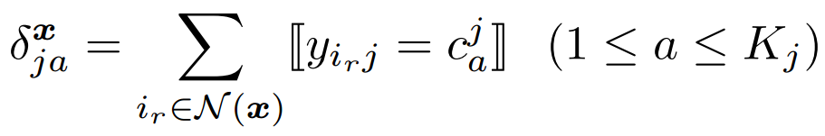
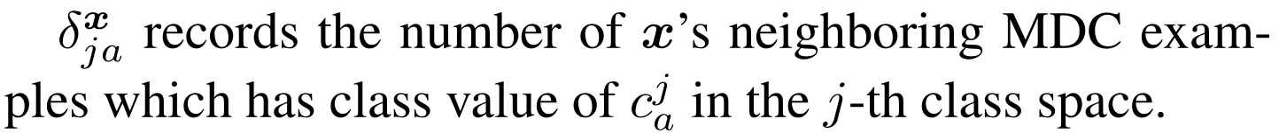
The KRAM Approach (1/4)
Key statistics of KRAM:
Here,
Notes:
As mentioned before, the key challenge of partial label learning is ambiguous labelling which means ground-truth label is not accessible by the learning algorithm. Generally, binary decomposition serves as intuitive solution which transforms multi-class learning problem into a number of binary leaning problems. However, due to ambiguous labelling, when we use one-vs-rest strategy, it is unclear whether the example (x_i, S_i) should be regard as a positive or negative example w.r.t. one specific class label, while when we use one-vs-one strategy, it is unclear which class label should example (x_i, S_i) belongs to w.r.t. a pair of class labels.

Slide 18
The KRAM Approach (2/4)
Feature augmentation of KRAM:
number of dimensions
number of class labels
in j-th dim.
kNN-augmented features
used for training and testing
Notes:
As mentioned before, the key challenge of partial label learning is ambiguous labelling which means ground-truth label is not accessible by the learning algorithm. Generally, binary decomposition serves as intuitive solution which transforms multi-class learning problem into a number of binary leaning problems. However, due to ambiguous labelling, when we use one-vs-rest strategy, it is unclear whether the example (x_i, S_i) should be regard as a positive or negative example w.r.t. one specific class label, while when we use one-vs-one strategy, it is unclear which class label should example (x_i, S_i) belongs to w.r.t. a pair of class labels.

Slide 19
The KRAM Approach (3/4)
Feature augmentation: an intuition
1st dimension
Label 1: 2
Label 2: 4
Label 3: 2
2nd dimension
Label a: 4
Label b: 2
Label c: 2
Left: 1st dim.(1/2/3)
Right: 2nd dim.(a/b/c)
kNN-augmented features:
Notes:
As mentioned before, the key challenge of partial label learning is ambiguous labelling which means ground-truth label is not accessible by the learning algorithm. Generally, binary decomposition serves as intuitive solution which transforms multi-class learning problem into a number of binary leaning problems. However, due to ambiguous labelling, when we use one-vs-rest strategy, it is unclear whether the example (x_i, S_i) should be regard as a positive or negative example w.r.t. one specific class label, while when we use one-vs-one strategy, it is unclear which class label should example (x_i, S_i) belongs to w.r.t. a pair of class labels.

Slide 20
The KRAM Approach (4/4)
Inputs:
Process:
Outputs:
(S1) Transform to by enriching the original feature space with kNN-augmented features.
(S2) Induce function f based on
(S3) Predict class vector of based on its augmented features (original features + kNN-augmented features)
Notes:
As mentioned before, the key challenge of partial label learning is ambiguous labelling which means ground-truth label is not accessible by the learning algorithm. Generally, binary decomposition serves as intuitive solution which transforms multi-class learning problem into a number of binary leaning problems. However, due to ambiguous labelling, when we use one-vs-rest strategy, it is unclear whether the example (x_i, S_i) should be regard as a positive or negative example w.r.t. one specific class label, while when we use one-vs-one strategy, it is unclear which class label should example (x_i, S_i) belongs to w.r.t. a pair of class labels.

Slide 21
The KRAM Approach (4/4)
Inputs:
Process:
Outputs:
Keypoint 1:
kNN-augmented features only represent as a first attempt towards MDC feature augmentation techniques
(S1) Transform to by enriching the original feature space with kNN-augmented features.
(S2) Induce function f based on
(S3) Predict class vector of based on its augmented features (original features + kNN-augmented features)
Notes:
As mentioned before, the key challenge of partial label learning is ambiguous labelling which means ground-truth label is not accessible by the learning algorithm. Generally, binary decomposition serves as intuitive solution which transforms multi-class learning problem into a number of binary leaning problems. However, due to ambiguous labelling, when we use one-vs-rest strategy, it is unclear whether the example (x_i, S_i) should be regard as a positive or negative example w.r.t. one specific class label, while when we use one-vs-one strategy, it is unclear which class label should example (x_i, S_i) belongs to w.r.t. a pair of class labels.

Slide 22
The KRAM Approach (4/4)
Inputs:
Process:
Outputs:
Keypoint 2: Meta-strategy
Any off-the-shelf MDC approaches can be utilized to instantiate KRAM
(S1) Transform to by enriching the original feature space with kNN-augmented features.
(S2) Induce function f based on
(S3) Predict class vector of based on its augmented features (original features + kNN-augmented features)
Notes:
As mentioned before, the key challenge of partial label learning is ambiguous labelling which means ground-truth label is not accessible by the learning algorithm. Generally, binary decomposition serves as intuitive solution which transforms multi-class learning problem into a number of binary leaning problems. However, due to ambiguous labelling, when we use one-vs-rest strategy, it is unclear whether the example (x_i, S_i) should be regard as a positive or negative example w.r.t. one specific class label, while when we use one-vs-one strategy, it is unclear which class label should example (x_i, S_i) belongs to w.r.t. a pair of class labels.

Slide 23
Outline
Introduction
The KRAM Approach
Experiments
Experiments setup
Experiments results
Conclusion
Notes:
I will introduce the experiments in the next part.

Slide 24
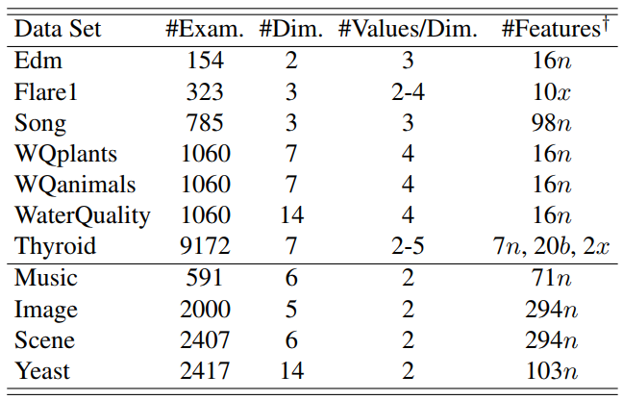
Experimental Setup
Experimental data sets
denote numeric, binary, and nominal features respectively.
Notes:
The experimental setup is as follows. There are 5 comparing algorithms with suggested parameter. The experimental protocol is ten-fold cross-validation and pairwise t-test.

Slide 25
Experimental Setup
Evaluation Metrics
Testing set:
Predicted class vector:
For each MDC test example
Hamming Score:
Exact Match:
Sub-Exact Match:
Notes:
The experimental setup is as follows. There are 5 comparing algorithms with suggested parameter. The experimental protocol is ten-fold cross-validation and pairwise t-test.

Slide 26

Experimental Setup
Meta-strategy
Comparing Algorithms
Binary Relevance (BR) [Read et al., TKDE14]
Ensembles of Classifier Chains (ECC) [Read et al., TKDE14]
Ensembles of Class Powerset (ECP) [Read et al., TKDE14]
Ensembles of Super Class (ESC) [Read et al., TKDE14]
Parameters Setting Details:
ECC: different random chaining orders
ESC: no NNR + Classifier Chains + T=1000,T’=0
For Ensemble methods(ECC/ECP/ESC):
Bagging (67%) + 10 base classifiers + majority voting
VS
Notes:
The experimental setup is as follows. There are 5 comparing algorithms with suggested parameter. The experimental protocol is ten-fold cross-validation and pairwise t-test.

Slide 27

Experimental Setup
Meta-strategy
Comparing Algorithms
Multi-Class Classifier
Support Vector Machines (SVM) [Chang & Lin, ACM TIST11]
Linear kernel and default setting for other parameters
Naïve Bayes (NB) : Gaussian pdf for continuous feature
Experimental Protocol
Ten-fold cross-validation + Pairwise t-test
VS
(parameter k=8)
Notes:
The experimental setup is as follows. There are 5 comparing algorithms with suggested parameter. The experimental protocol is ten-fold cross-validation and pairwise t-test.

Slide 28
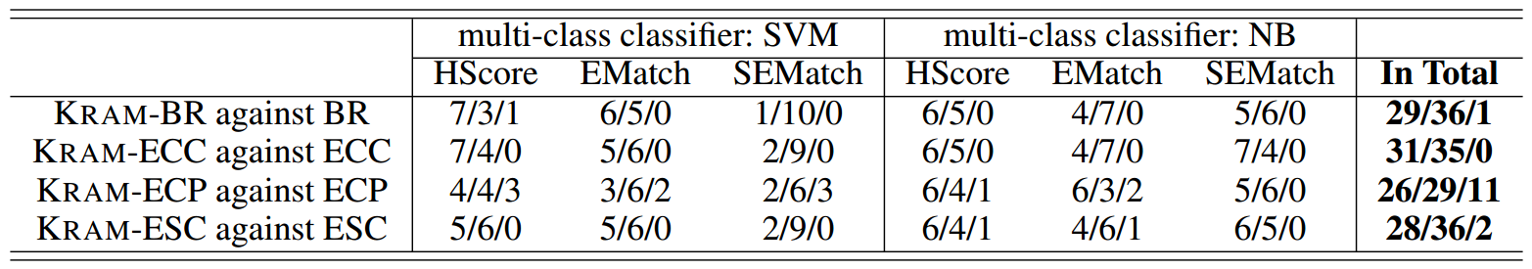
Experimental Results
Win/tie/loss counts of pairwise t-test (at 0.05 significance level) between each MDC approach and its KRAM counterpart in terms of hamming score (HScore), exact match (EMatch), and sub-exact match (SEMatch)
Totally, there are only 14 loss cases across all the 264 configurations.
Not only performance of BR (not modeling dependencies among class spaces) is improved, but also performance of ECC/ECP/ESC (modeling dependencies among class spaces explicitly) are improved.
There are more loss cases in ECP than BR/ECC/ESC.
Notes:
Six UCI data sets are used in our experiments, and we generate artificial PL data sets from them by using three controlling parameters.
Here, p controls the proportion of examples with partial labels, r controls the number of false positive labels in candidate label set, and epsilon controls the co-occurring probability for the coupling label.

Slide 29
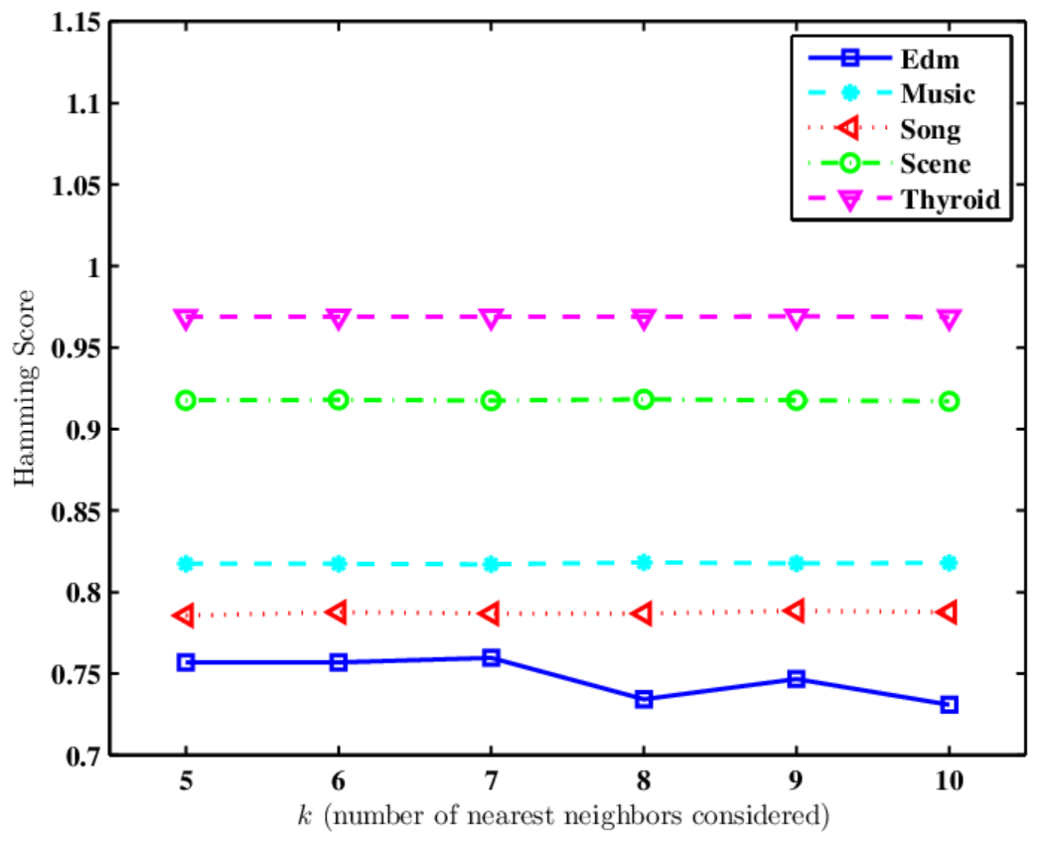
Sensitivity Analysis
Performance of KRAM-BR changes as k ranges from 5 to 10 in terms of Hamming Score
Notes:
In the parameter sensitivity analysis, we can see that performance of PALOC improves as miu increases from zero and becomes relatively stable as miu reaches four. Specially, when $mu$ takes the value of 0, it corresponds to the case where only ovo classifiers contribute to the final prediction. These observations indicate that the stacking classifiers do help improve the performance.

Slide 30
Outline
Introduction
The KRAM Approach
Experiments
Experiments setup
Experiments results
Conclusion

Slide 31
Conclusion
Main Contribution
Propose a new strategy aiming at manipulating feature space for multidimensional classification.
Design a simple yet effective approach based on kNN-augmented features to justify the proposed strategy.
Future Work
Explore other ways for MDC feature space manipulation.
Design feature augmentation techniques customized for specific MDC approach .
Notes:
In conclusion, our main contribution is to enable binary decomposition for partial label learning. And the key technique is to adapt one-vs-one decomposition and utilize the stacking strategy. In the future, we will explore possible ways to make full use of the excluded PL training examples during binary decomposition.

Slide 32
Thanks !
Q & A

